Slide 1

Python! Day 19
CSV files and the squirrel census map
US State Guessing Game

Slide 2
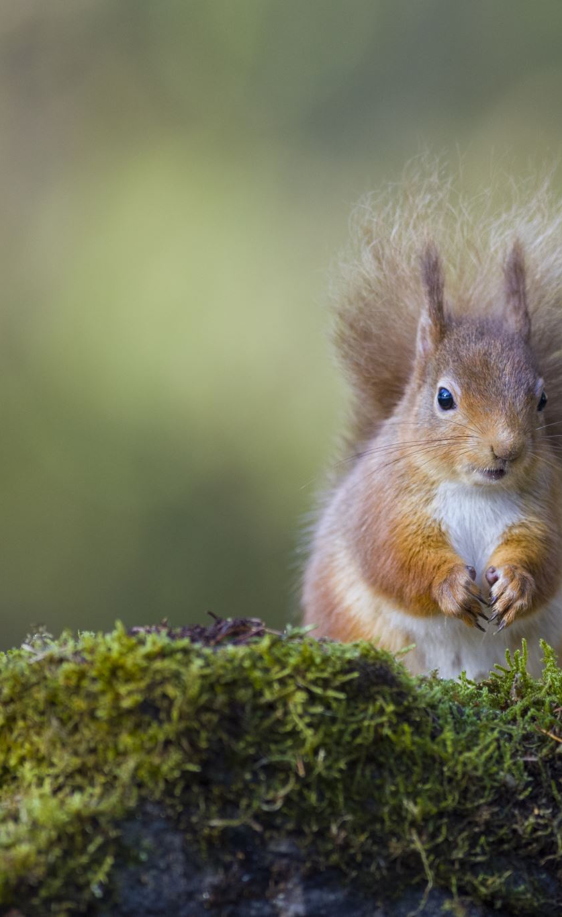
Project: 2018 Squirrel Census Fur Color Map
In 2018, there was a group of people who tracked down every squirrel in NYC’s Central Park and recorded a bunch of information about each squirrel
We can access this squirrel census data by searching “2018 Squirrel Census Fur Color Map” and clicking on the first link
The data collectors took note of each squirrel’s age, location, actions, primary fur color, etc.
We can access this data in CSV format by pressing ‘export’ and then ‘CSV’
Next, let’s drag this file into our project

Slide 3
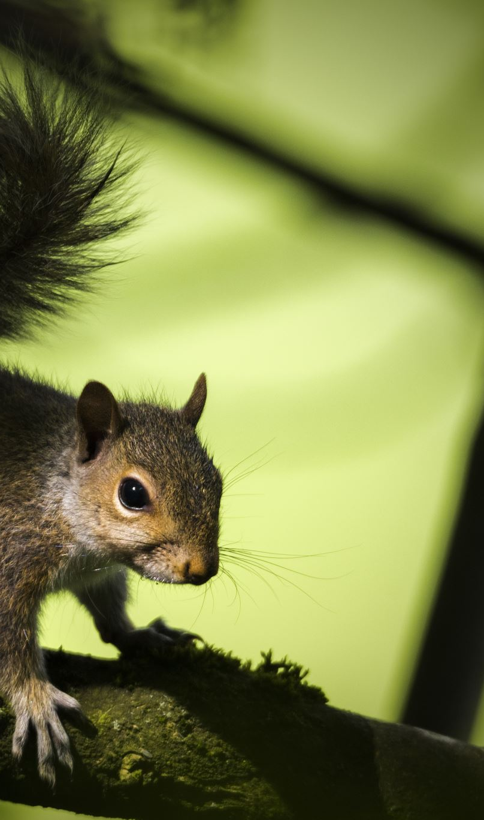
Project: 2018 Squirrel Census Fur Color Map
For this project, we want to look at each squirrel’s Primary Fur Color and count how many squirrels are Black, Cinnamon, and Gray
Then, we’ll want to create a small CSV file to store this data
This will show how we can use pandas to handle huge amounts of data at once

Slide 4
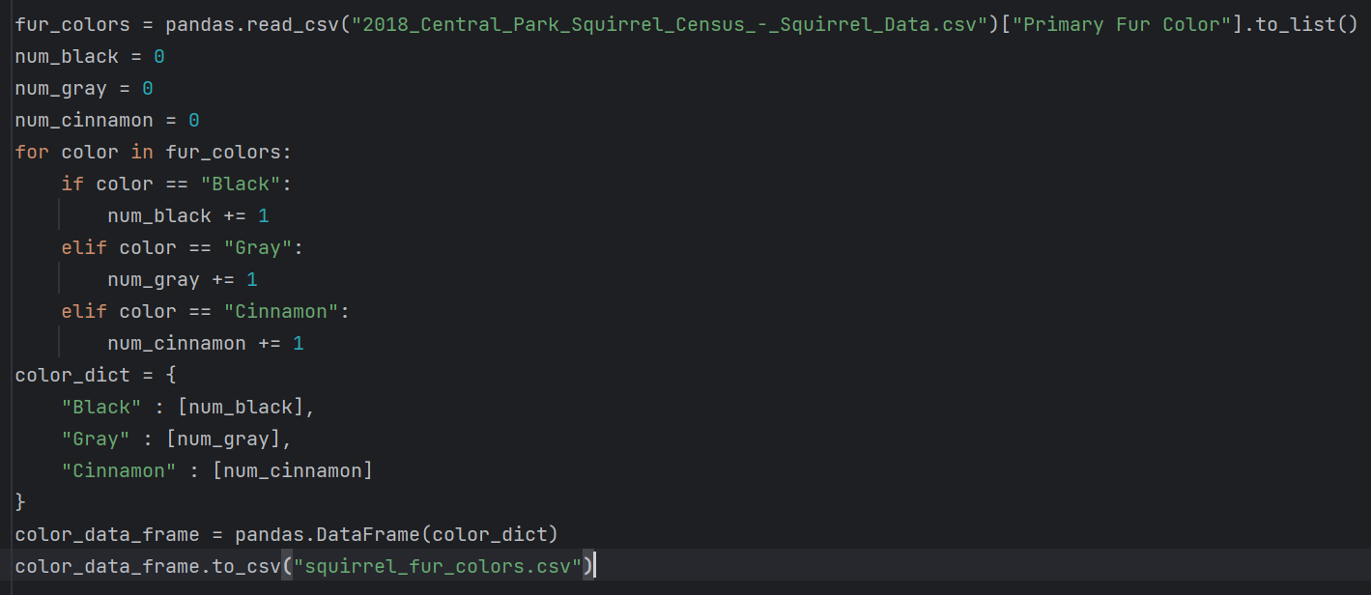


Slide 5
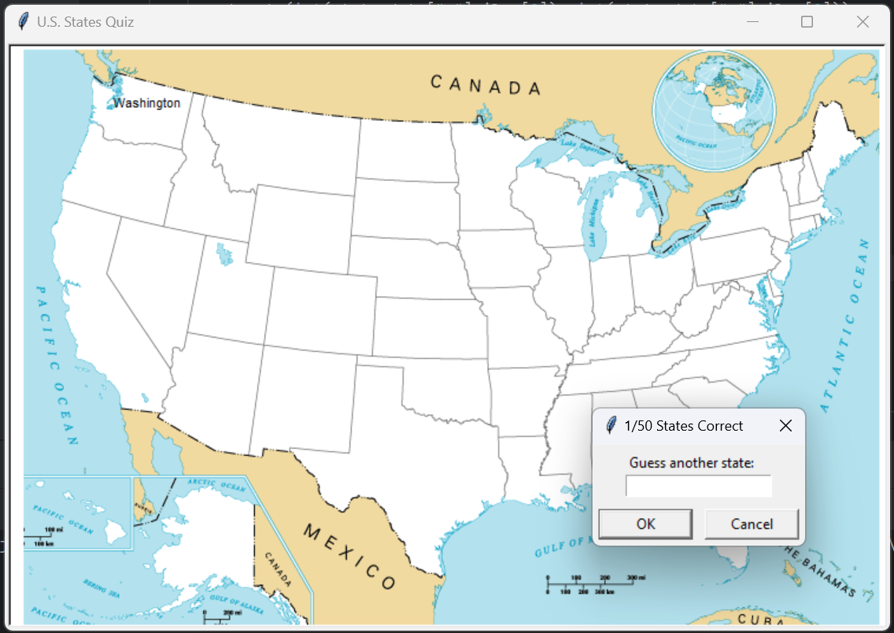
Project: US State Guessing Game
CSV files aren’t only useful for tracking data. They can also be used to track information for video games
For this next project, we’ll create a game where the player has to label all 50 US States on a blank US map
To do this, we’ll use CSV files and turtle

Slide 6
Project: US State Guessing Game - Steps
Setup the project
Add the map
Get each state’s coordinates
Get the player’s state guess
Add state labels when the user guesses correctly
Make the code repeat
Make our text input box more accepting
Allow the player to exit the game
Asses the player’s performance
Final touches

Slide 7

Step 1: Setup
To build the state game, we’ll need to start by doing some setup
First, let’s create a new project called “50StateGame”
And we can create our main.py file as well
Next, let’s download the files we need for this project from my github repository
https://github.com/Tavishi27/Tuesday-Python-Files
The needed files are in the 3-26 branch
Using these files will save us a lot of time and effort

Slide 8
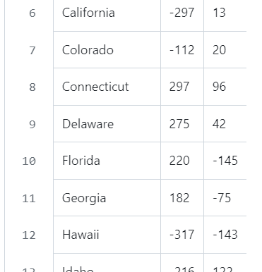
Step 1: Setup
Next, let’s drag the two files into our new Python project
The “blank_states_img.gif” file will allow us to display an image on our turtle screen
The “50_states.csv” file will give us the necessary information on each state
Now, let’s go into our main.py file and setup a turtle screen:
import turtle
s = turtle.Screen()
s.title(“U.S. States Quiz”)
s.exitonclick()

Slide 9
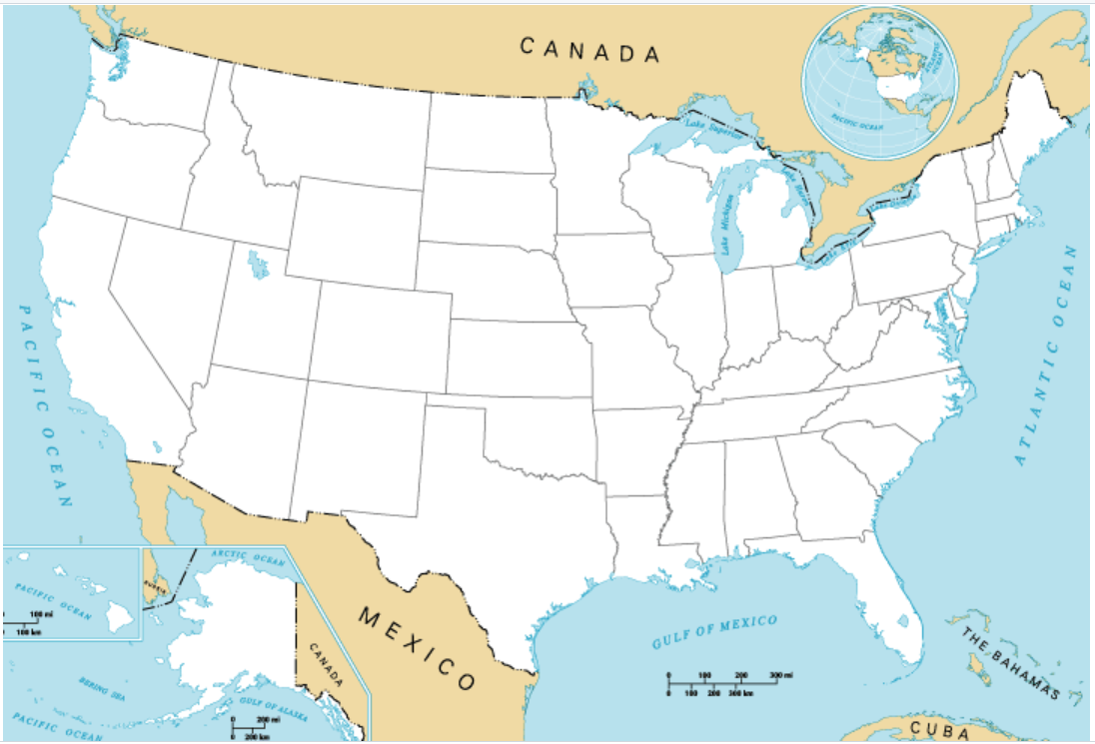
Step 2: Adding the map
One interesting thing we can do with the turtle class is that we can make a turtle’s shape an image
We’re going to use this to create a turtle that looks like our map file
First, we need to register the image as a shape:
image = “blank_states_img.gif”
s.addshape(image)
Next, we can create a turtle with our new shape:
turtle.shape(image)

Slide 10

Step 3: Getting Each State’s Coordinates
Now, we’ll want to find the coordinates of each state on the map so we know where to put the state name when the user guesses it
To do that, we can write some code that prints the location of wherever the user clicks, and then we can click on the center of each state
The code would look like this:
def get_mouse_click_coor(x, y):
print(x, y)
turtle.onscreenclick(get_mouse_click_coor)
turtle.mainloop()
#s.exitonclick()
Note: we must comment out s.exitonclick() for this to work

Slide 11
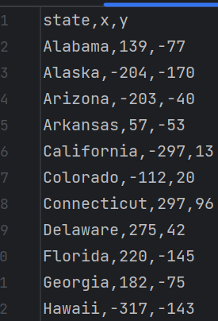
Step 3: Getting Each State’s Coordinates
Now, we can click on each state, and the console will print the coordinates of each click
However, recording each of these coordinate points would be really tiresome and annoying
So, instead, we can use the x and y values already recorded for each state in our CSV file
So, we can delete/ comment out the code we just wrote and read our CSV file instead

Slide 12

Step 3: Getting Each State’s Coordinates
So, if we want to get each state’s coordinates from our CSV file, we’ll need to download and import pandas again
To download pandas: Main Menu/Python > Settings > Project:50StateGame > Python Interpreter > +
Now, search ‘pandas’ in the search bar, click on the pandas module, and press ‘install package’
Now, we can write “import pandas” at the top of our CSV file
Next, we can use the pandas.read_csv() method to get our data:
data = pandas.read_csv("50_states.csv")

Slide 13
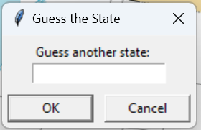
Step 4: Get the Players State Guess
Now, we need to use a text pop-up box to ask the user to guess a state name
We can do this using the screen.textinput() method:
user_guess = s.textinput(title="Guess a State", prompt="Guess another state:")
print(user_guess)
Next, we must check if the user guessed a valid state. We can do this by getting a list of all the state names and using the in keyword
all_states = data[“state”].to_list()
if user_guess in all_states:
print(user_guess)

Slide 14
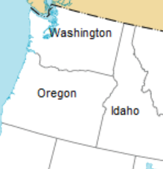
Step 5: Add State Labels when the User Guesses Correctly
To do this, we’ll need to create a turtle object that goes to the correct x and y location and writes the state’s name
user_guess = s.textinput(title="Guess a State", prompt="Guess another state:")
if user_guess in all_states:
t = turtle.Turtle()
t.penup()
t.hideturtle()
state_data = data[data["state"] == user_guess]
t.goto(int(state_data["x"].iloc[0]), int(state_data["y"].iloc[0]))
t.write(user_guess, align="center")

Slide 15
Step 6: Make the Code Repeat
Now, we’ll want to make the input text box repeat until the user has guessed all 50 states
We can do this by creating a variable called num_states_guessed and set it to 0
Now, we can create a while loop with the condition num_states_guessed < 50, and put our text box code inside
Whenever the user guesses a state correctly, num_states_guessed should increase by 1
The state the use guessed should also be removed from all_states so the user can’t guess the same state a whole bunch of times

Slide 16
Step 6: Make the Code Repeat
num_states_guessed = 0
while num_states_guessed < 50:
user_guess = s.textinput(title=str(num_states_guessed) +"/50 States Correct", prompt="Guess another state:")
if user_guess in all_states:
t = turtle.Turtle()
t.penup()
t.hideturtle()
state_data = data[data["state"] == user_guess]
t.goto(int(state_data["x"].iloc[0]), int(state_data["y"].iloc[0]))
t.write(user_guess, align="center")
all_states.remove(user_guess)
num_states_guessed += 1

Slide 17
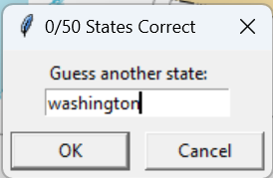
Step 7: Make our Input Box More Accepting
Right now, if we run our code, the user’s answer is only registered as correct if it is written in title case (with the first letter of every word capitalized)
Let’s change our code so that a user can type their answer in all lowercase or all uppercase or something weird and it can still be registered as correct
To do this, we can edit the user’s textinput like this:
user_guess = s.textinput(title=str(num_states_guessed) +"/50 States Correct", prompt="Guess another state:").title()

Slide 18
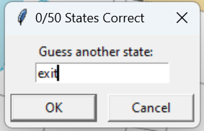
Step 8: Allow the Player to Exit the Game
Right now, the only way to exit the game is to finish guessing all 50 states
But most players won’t be able to guess all 50 states and will want to exit at some point
To allow this, we can check if the user’s guess is “Exit”
If it is, we’ll break out of our while loop with the break keyword
if user_guess == "Exit":
break

Slide 19
Step 9: Assess the Player’s Performance
At the end of the game, we should tell the user how many states they were able to name and which ones they missed
To do this, we can replace the s.exitonclick() statement with print statements telling the user their final score and printing all the states left in the all_states list
print("Congrats! You got " + str(num_states_guessed) + "/50 States!")
print("You missed: ")
print(all_states)

